Slide 1

ADICIA
Voxel Metaverse Game and Game Maker
Aditya Gautam

Slide 2
A Voxel based unique virtual world where players can play, own, and monetize content and gaming experiences.
A Play To Earn (P2E) game similar to Minecraft or Sandbox with an in-build Game Maker which will allow the Player to make complex games (puzzle and other genres) without any technical knowledge.
User Generated Game Design and Monetization is main focus of the this platform. Players are incentivized to not only Play-To-Earn (P2E), but also to build Games and Monetize them.
Inside this Platform we will have A Metaverse game, A Game Maker and NFT Game Marketplace
Gamers are our main audience who will earn NFT by playing it, but also Creators who will build complex NFT games with templates, scripts and Visual Editors and monetize them through NFT Game Marketplace

Slide 3
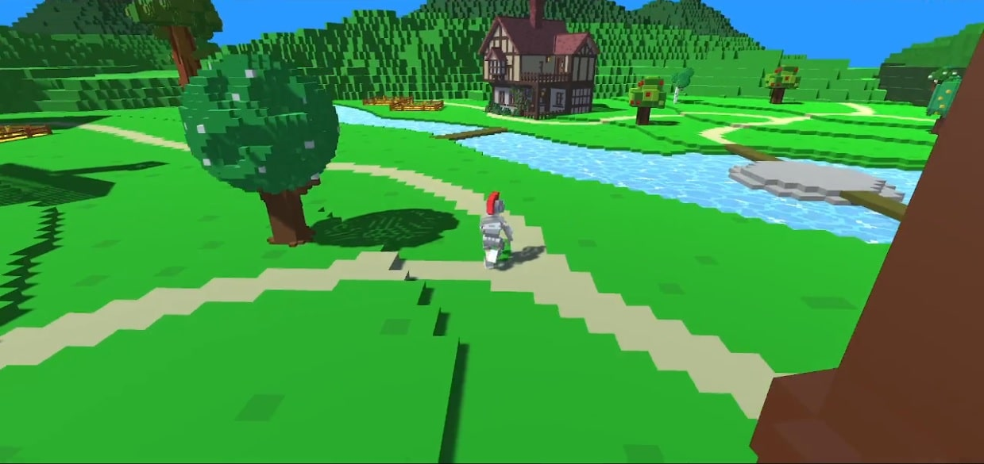
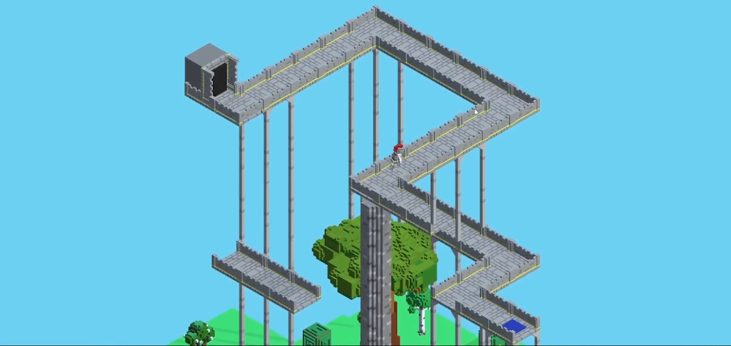
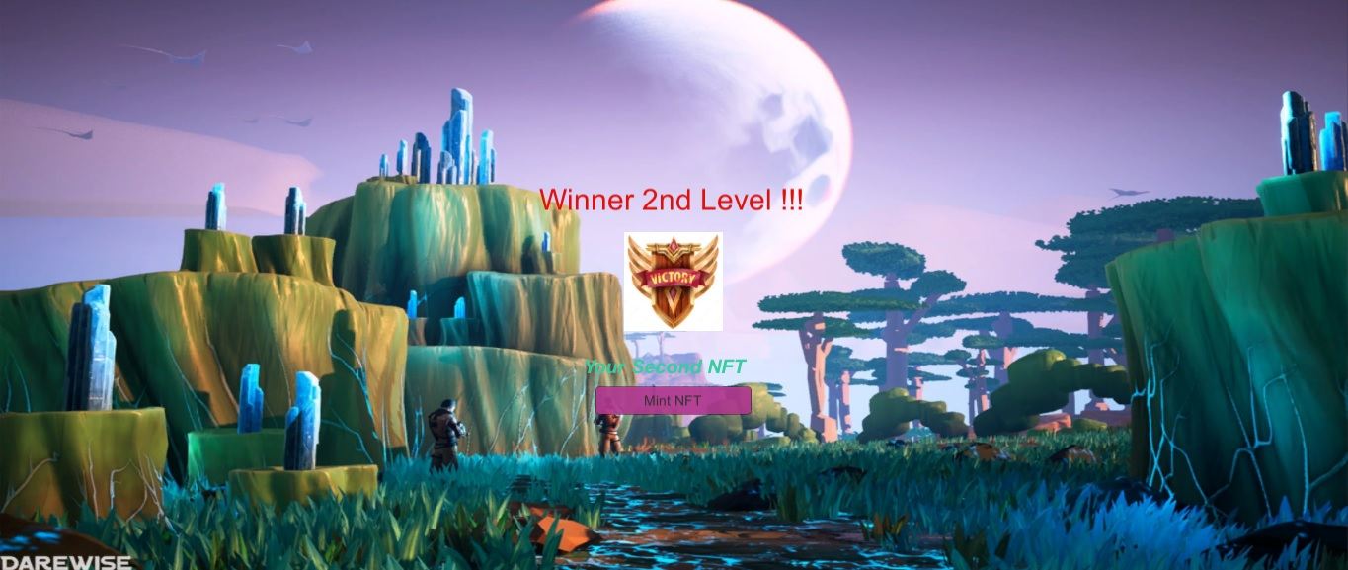
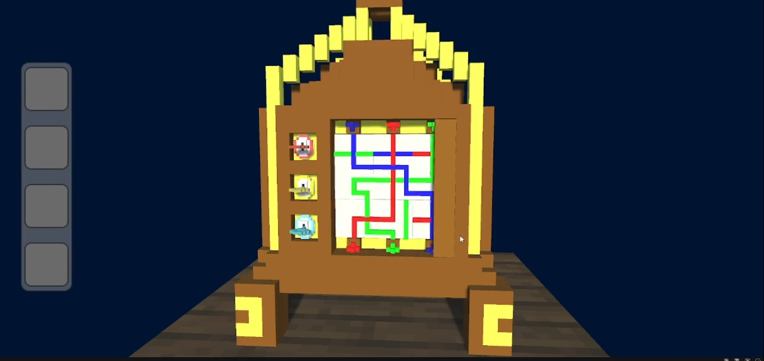
The Game
Metaverse
Puzzle
Mint NFT

Slide 4
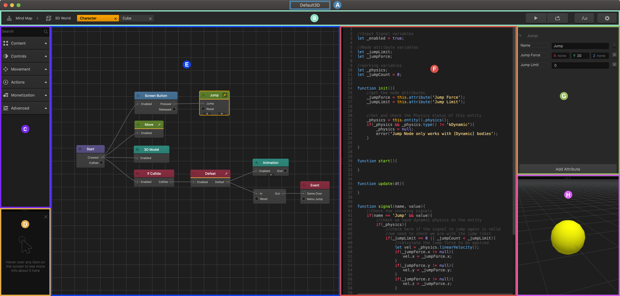
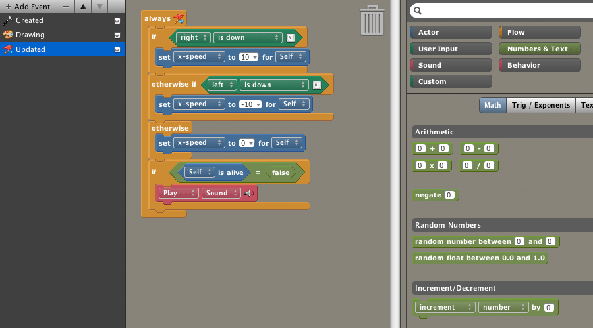
Game Maker
Visual Scripting
Lego-style code blocks

Slide 5
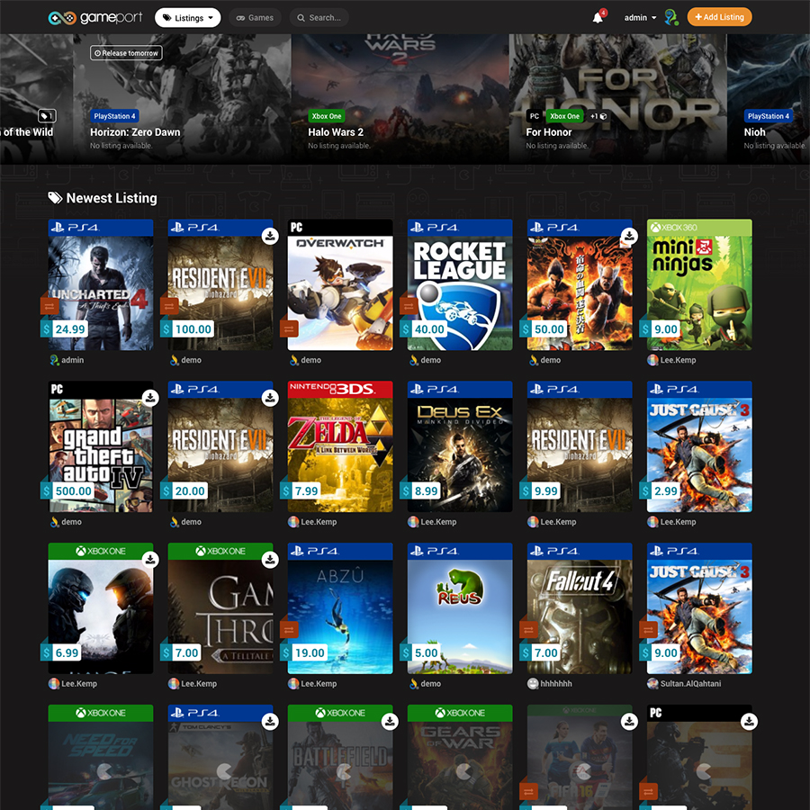
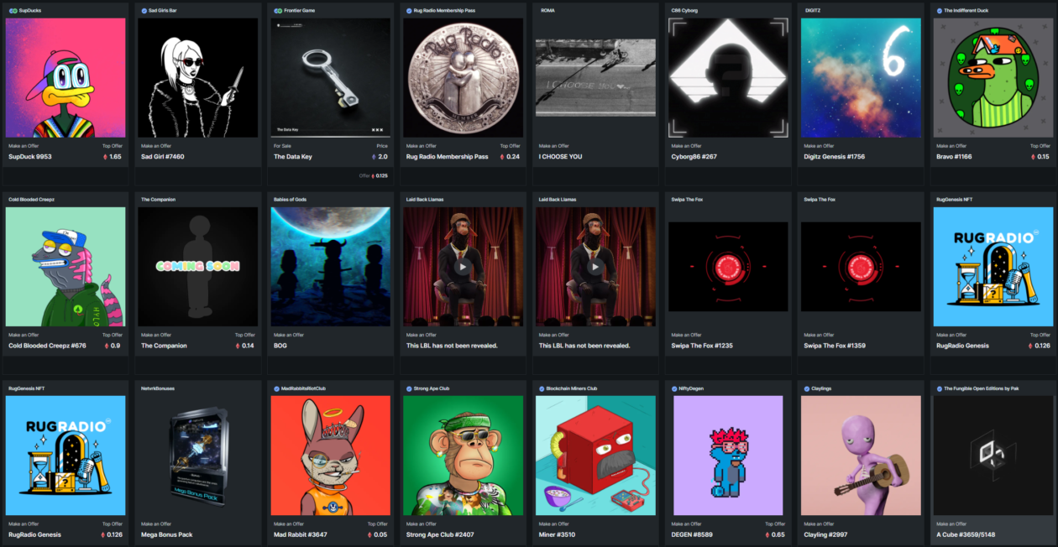
NFT Marketplace
NFT Game
Marketplace

Slide 6
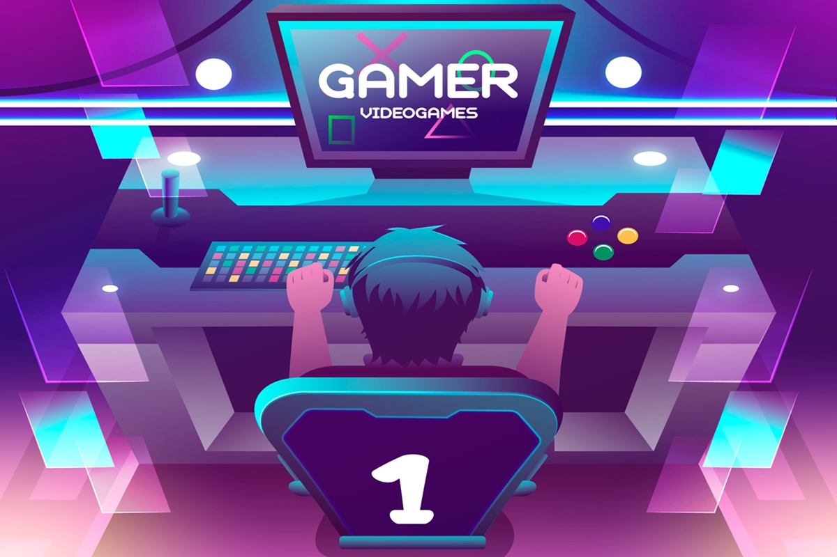
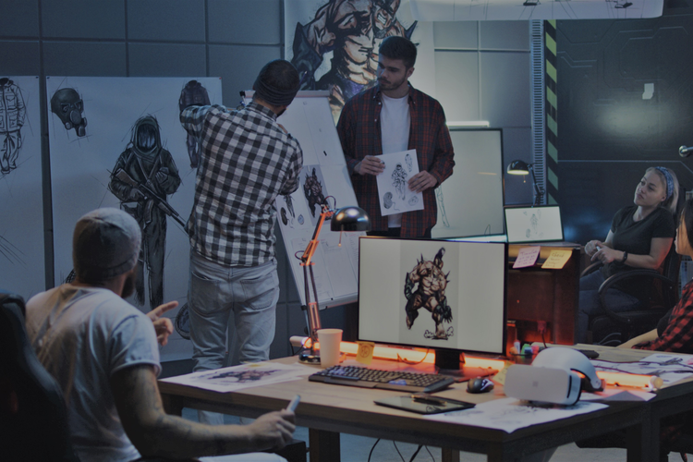
Target Audience
Gamers
Game Creators

Slide 7
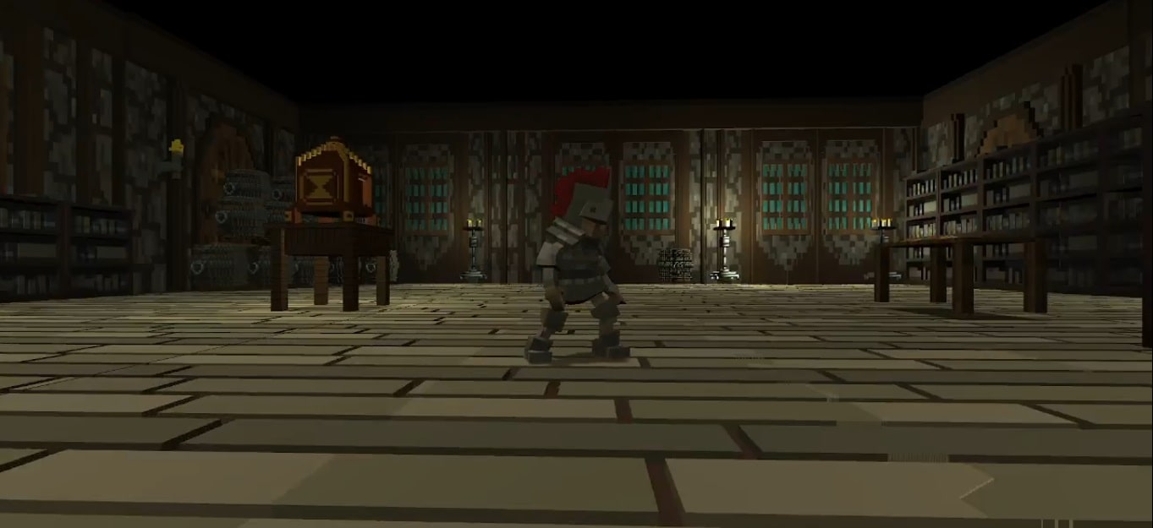
Game Play
Metaverse
Puzzle
Mint NFT

Slide 8
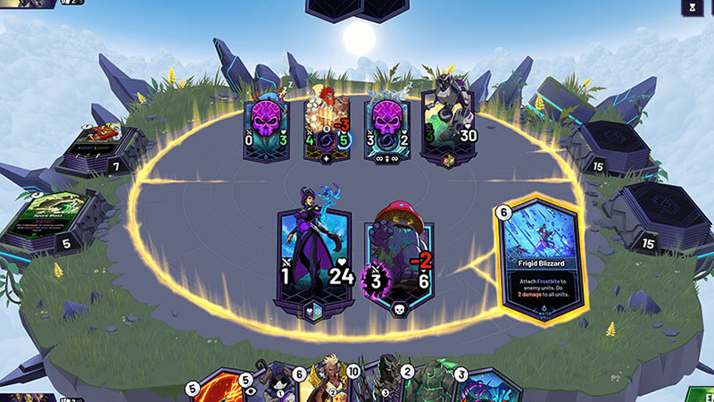
Future Road Map
Real-Time NFT Card Battle System

Slide 9
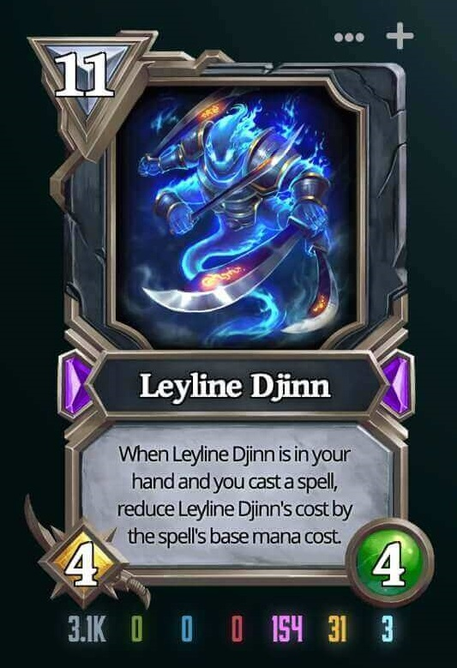
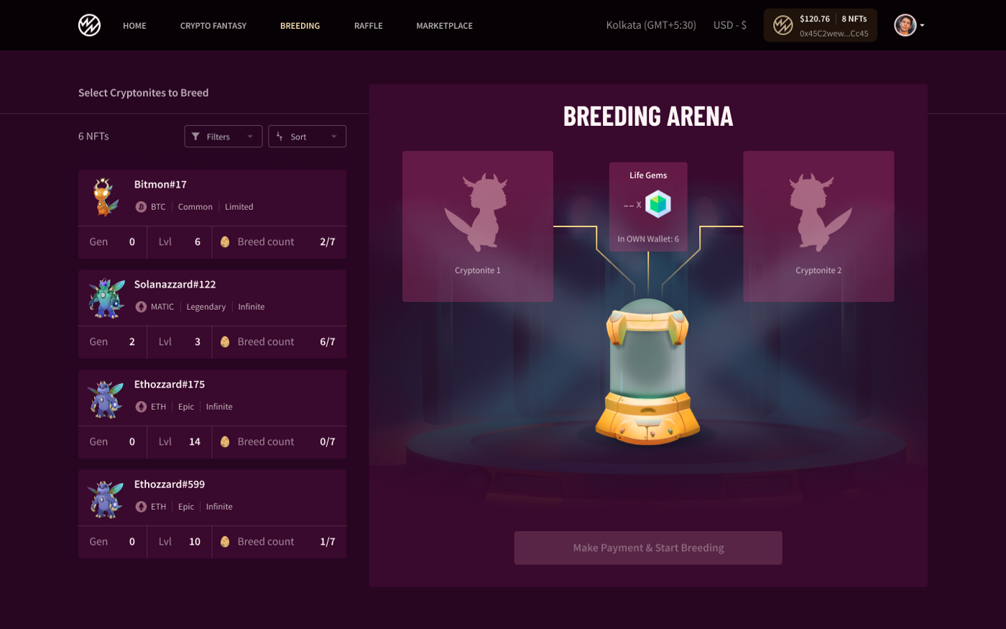
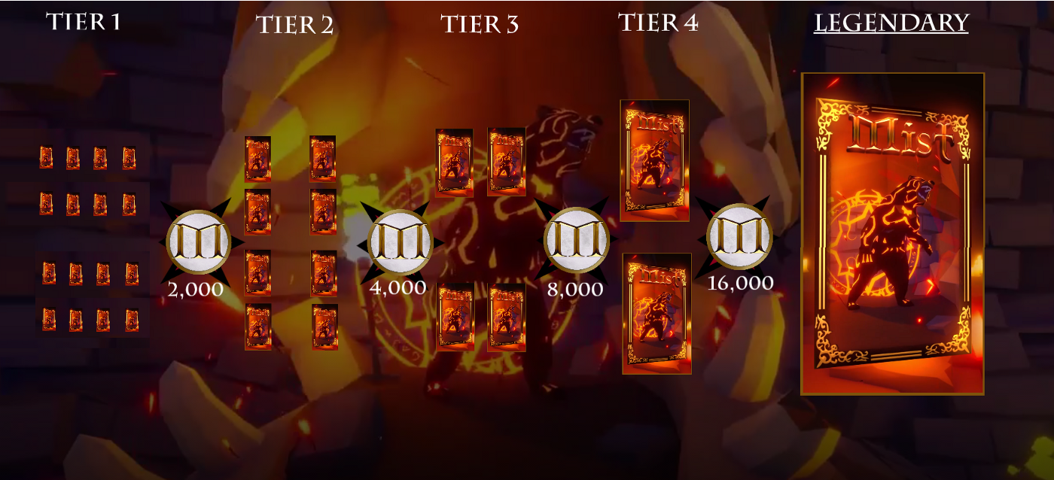
Integration of NFTs
Advanced NFTs
Breed NFT by Combining 2 NFTs
Boost and Upgrade NFTs

Slide 10
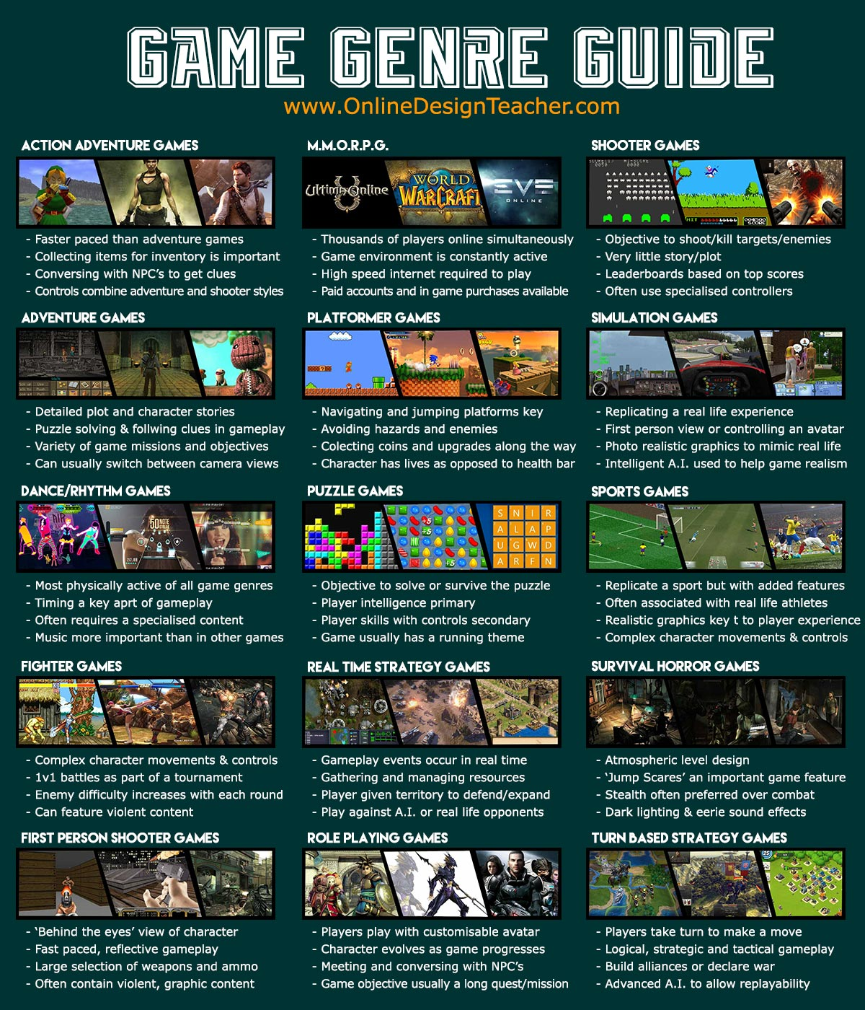
Adding More Levels of Gameplay There are only two levels of Gameplay is available to Play. We need at least 20-25 levels of Gameplay to make it engaging for players to play. We also need soundtracks to be included in the Game. The following genre of Games are needed to be included in the Game:- 1- Optical Illusion 2- Physics-Based Puzzle (Finding Clue, sliding Puzzle, 3- 3-Combination Puzzle, Match3, jigsaw) 3- Board game (Hitman Go) 4- Action adventure 5- MMORPG 6- City Builder (construct building) 7- Tower defense 8- Turn-Based game 9- RPG adventure 10- Fighting 11- Real time strategy Other genres of Games.

Slide 11
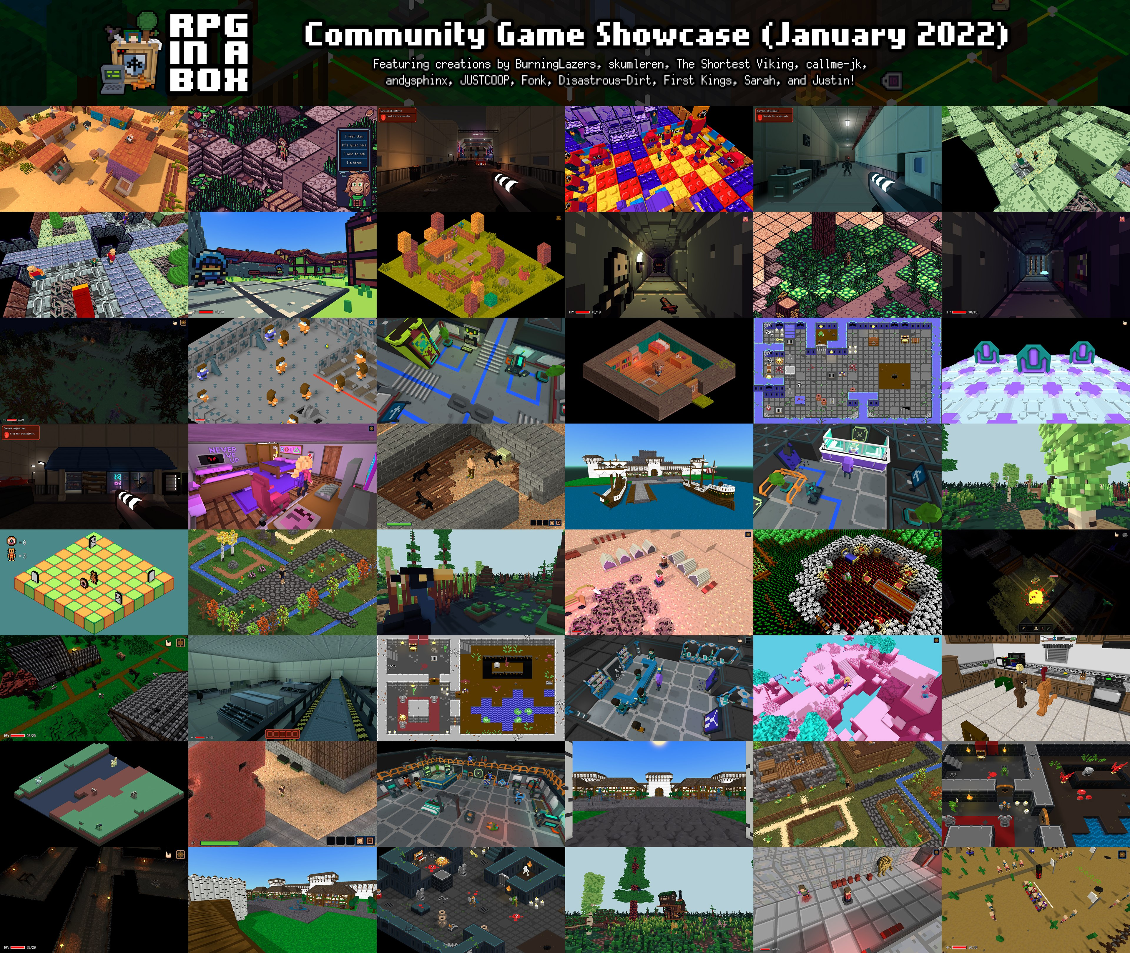
Add More Voxel Open World

Slide 12
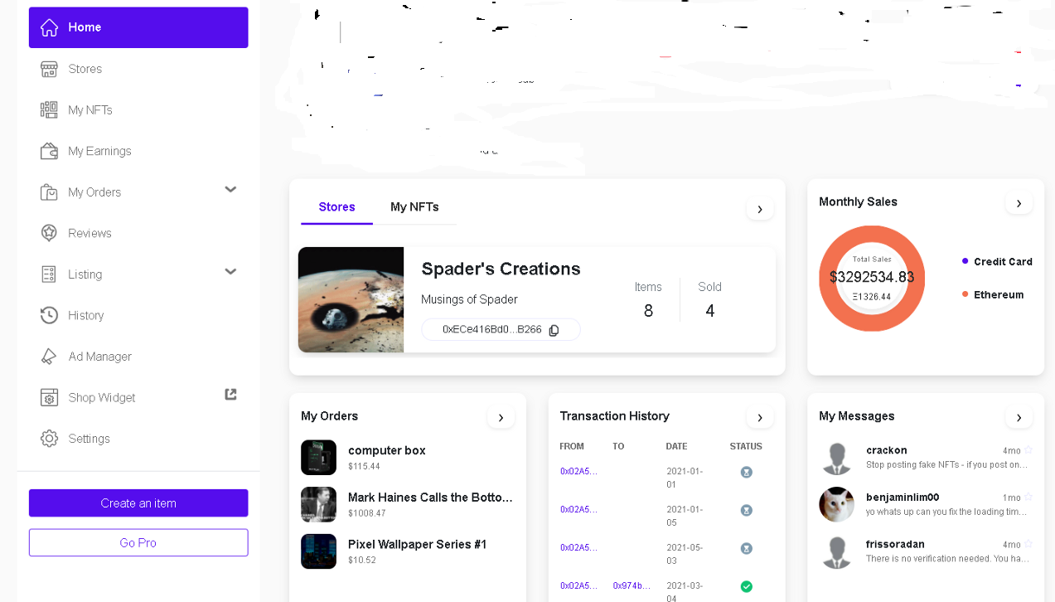
NFT Game Marketplace
With Review System

Slide 14


